Slide 1


EXPLORATORY DATA ANALYSIS Capstone Project 01
Play store app review analysis

Slide 2
Content
Introduction
Problem Statement
Attributes in Data
Data cleaning
Transforming Data
Data exploration
Basic observation
Insights from data
Conclusion
Reference
Notes:
Today’s Content will be as follows:
1. We will recap the overall project to give a high level understanding of the business problem we're tackling and the specific requirements.
2. We will dive into the specific problem that we, the Data Analytics team, have been focusing on and will give some background as to why this is such a big problem.
3. After introducing the problem, I will go over the team responsible from our side in tackling this task.
4. I will then go over the high-level process that we followed to complete this task, so that you have complete clarity in how we tackle these kinds of tasks.
5. Finally, I will go over the all important results and I will present them as a series of insights and visualizations from our analysis.
To wrap up, I will summarize and open for any questions

Slide 3
Analytics Team Mates
AKANKSHA
JADHAV
NEHA JADHAV
AKRITI PANCHBUDHE

Slide 4




WHY WE ANALYZE THE PLAY STORE?
Mobile App Market is set to grow 20% by 2023
Android apps comprise 75% of the Market Share. 85% sharein Brazil, India, Turkey
What are some interesting patterns in user behavior related to app usage & feedback
What makes an App popular? Can we predict how popular it’s going to be?

Slide 5
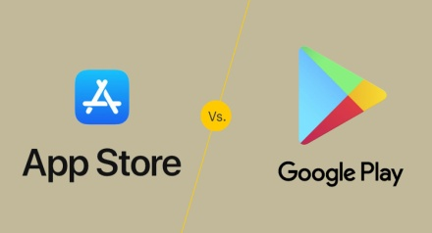
Introduction
Google Play was launched on March 6, 2012.
Google Play is an online store where people go to find their favorite apps, games, movies, TV shows, books, and more.
It provides 2 million apps & games to billions of people around the world, generating over $120 billion in earnings for developers to date.
The main objective of the Project is that to understand the Users demand what they expecting from using their apps and thus it helps to update and develop the product by Developers.
Google Play Store is found to be the largest app market in the world. It has been observed that although it generates more than double the downloads than the Apple App Store but makes only half the money compared to the App Store.

Slide 6
Problem statement
Two datasets are provided, one with basic information and the other with user reviews for the respective app.
We must examine and evaluate the data in both datasets in order to identify the important characteristics that influence app engagement and success.
For this project we analyze Play store data of 2017-2018 ,Google playstore is mostly use app store worldwide also top global market share.
Our main objective is to find key factor responsible for app success
and engagement of users.
Thousands of new app regularly update playstore of different category.
We found distribution of every app based on their size, installs, reviews and much more.

Slide 7

Attributes in Google Playstore Data
This contains data on the Google Play applications. It has 10,841 rows of data which has following columns.
App Category: Category of the app. This could be beauty, business, medical,art and design entertainment, education, family...etc.
Rating: It has How users rate the app out of 5, with 1 being the lowest rating and 5 being the highest.
Reviews: number of user reviews each app has received.
Size: The memory size needed to install the application.
Installs: The number of times each application has been installed by users.
Type: Whether the app is free or a paid app.
Price: The price of the app.
Content Rating: This column specifies the intended audience for the app. Can be for teens, mature audience, or everyone.
Genres: The sub-category for each app. Example: for the Education category, this could be Education: Pretend Play, for example.
Last Updated: Release date of the most recent update for the app.
Current Ver: The app's current version.
Android Ver: The oldest version of Android OS supported by the app.

Slide 8

Attributes in User Reviews
Sentiment Analysis: This file contains the result of the sentiment analysis conducted by the dataset creator. It has 64,295 rows of data with the following columns:
App : Name of the app.
Translated_Review: Either the original review in English, or a translated version if the orignal review is in another language.
Sentiment: The result of the sentiment analysis conducted on a review. The value is either Positive, Neutral or Negative.
Sentiment_Polarity: A value indicating the positivity or negativity of the sentiment, values range from -1 (most negative) to 1 (most positive). Sentiment polarity for an element defines the orientation of the expressed sentiment, i.e. it determines if the text expresses the positive, negative or neutral sentiment of the user about the entity in consideration.
Sentiment_Subjectivity: A value from 0 to 1 indicating the subjectivity of the review. Lower values indicate the review is based on factual information, and higher values indicate the review is based on personal or public opinions or judgements.

Slide 9

Data Cleaning
Google Play store dataset has 10,841 observation of data with fields.
User reviews dataset has 64295 observation of data with fields.
Two data set -1) play store data 2) user reviews
List of fields:
App
Category
Rating
Reviews
Size
Installs
Type
Price
Content rating
Genres
Last updated
Current version
Android version
App
Translated review
Sentiment
Sentiment polarity
Sentiment subjectivity
Playstore data
User reviews

Slide 10
Cleanse and validate data
Understand the structure of the dataset and clean data before analysis
Removing extraneous data
Finding Missing value in dataset.
Correct data type(INT, FLOAT, DATE).
Replace null value with aggregate function (mean, mode , median).
Checking outliers.
Conforming data to a standardized pattern.

Slide 11
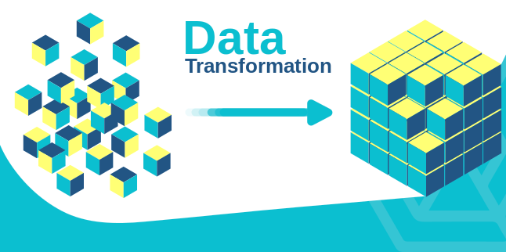
Transform data
Transforming data is the process of updating the format or value entries in order to reach a well-defined outcome, or to make the data more easily understood by a wider audience.
The dataset collected from the Play store is semi structured or unstructured and contains significant superfluous data (defined as not contributing significant meaning).Some data type needs to change in required format as int, float, date.
we will be working with most frequently henceforth are Installs, Size, Reviews, Rating and Price.

Slide 12


Exploratory data analysis
Exploratory data visualizations (EDVs) are the type of visualizations we assemble when we do not have a clue about what information lies within our dataset.
With more than 1 billion active users in 190 countries around the world, Google Play continues to be an important distribution platform to build a global audience. For businesses to get their apps in front of users, it's important to make them more quickly and easily discoverable on Google Play. To improve the overall search experience, Google has introduced the concept of grouping apps into categories.
Let's move to the visualization part-

Slide 13
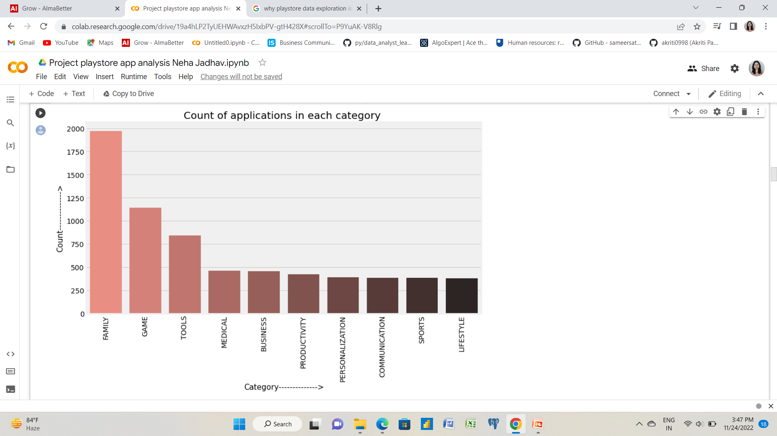
Count of applications in each category
Now we know that the 'Family' and 'Game' category rules the play store market, followed by Tools, Medical, and Business. Okay Cool ..... Data Analytics will understand our daily requirements and fill the market with similar apps.

Slide 14
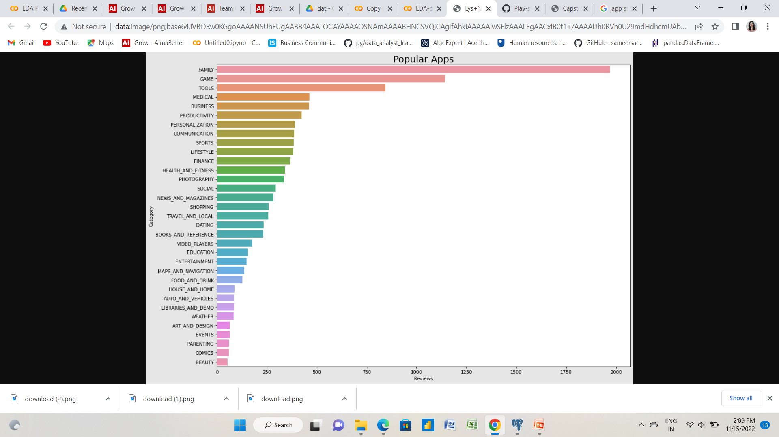
Popular Apps with respect to reviews
From above barplot we can see that there are total 33 different categories in the dataset.
The most popular apps are from 'Family' and 'Games' category. The least reviews are for the apps from 'Beauty' and 'Comics' Category.

Slide 15
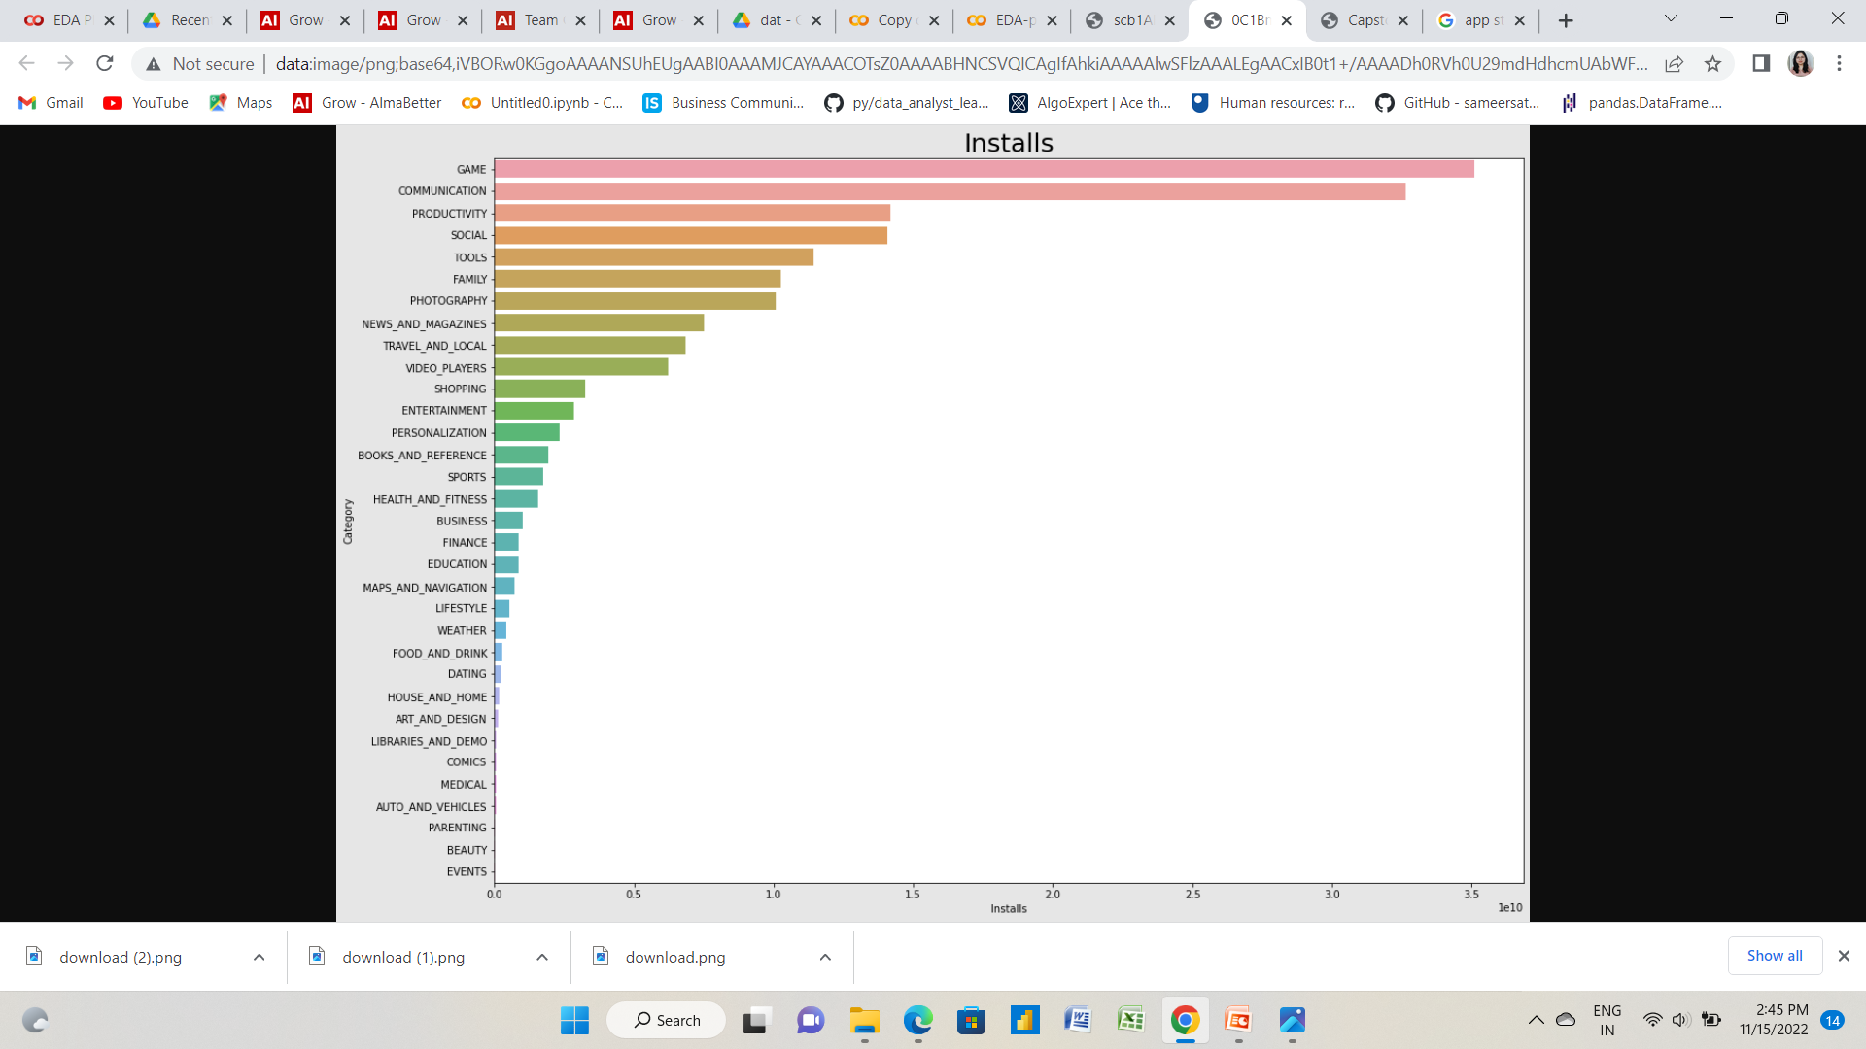
Top Installed categories with respect to categories
We can see that most of the apps has been installed from 'Game' and 'Communication' category.
Let's see which apps are most installed Category wise.

Slide 16

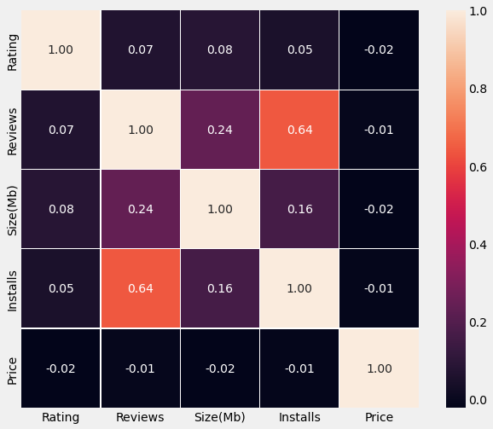
Correlation Heatmap between the columns
From the above heatmap we can see that the 'Reviews' and 'Installs' columns has most correlation.
It is much more obvious that a higher number of installs has a higher number of reviews. There is a negative correlation between price and install apps, with the price of the app influencing the number of installation of the app.

Slide 17
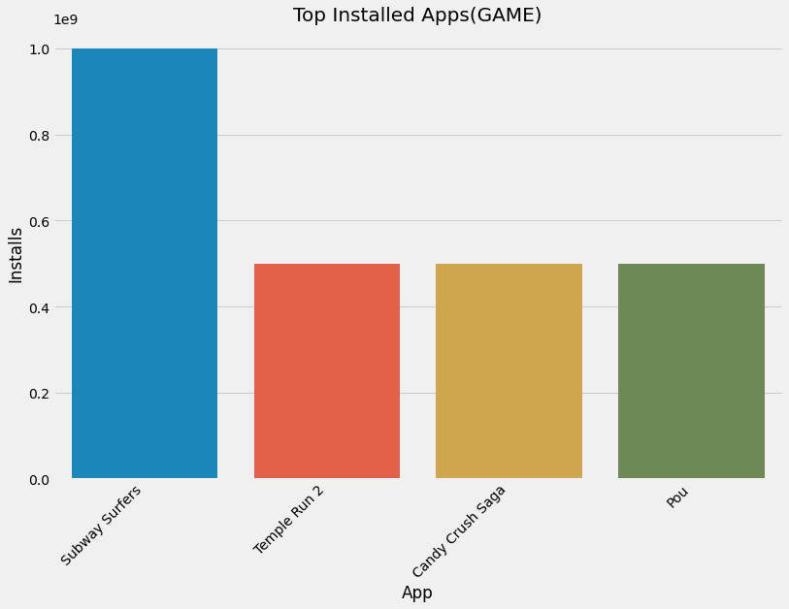
Top Installed gaming Apps
From the above plot we can see that the most installed games from the 'Game' Category are 'Subway Suffers', 'Temple Run 2', 'Candy Crush Saga' and 'Pou'.

Slide 18
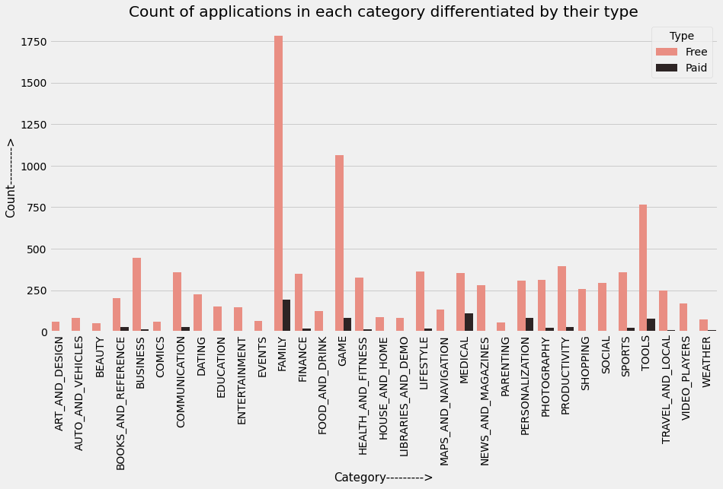
Count of Applications in each category differentiated by their type
It looks like certain app categories have more free apps available for download than others. In our story, the majority of apps in the Family, Game, and Tools categories were free to install.
At the same time Family, Medical, Tools, and Game categories had the biggest number of paid apps available for download.

Slide 19

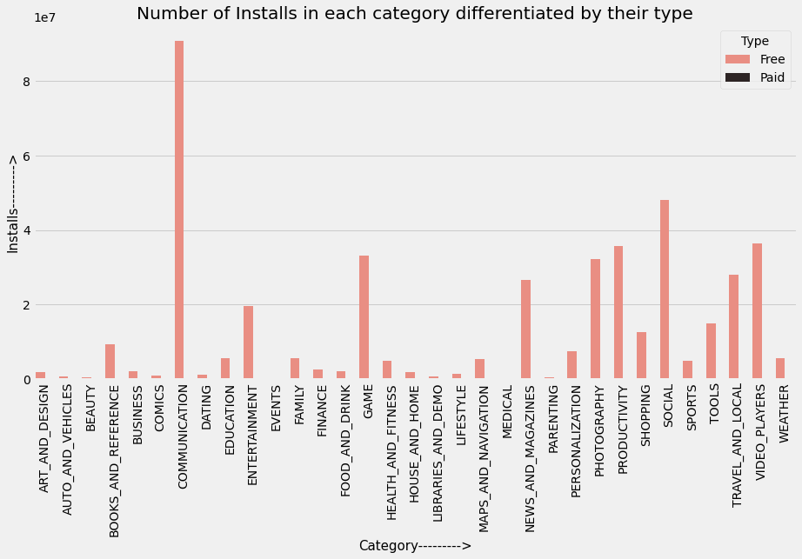
Number of installs in each category differentiated by their type
It can be concluded that the number of free applications installed by the user is high when compared with the paid ones.

Slide 20
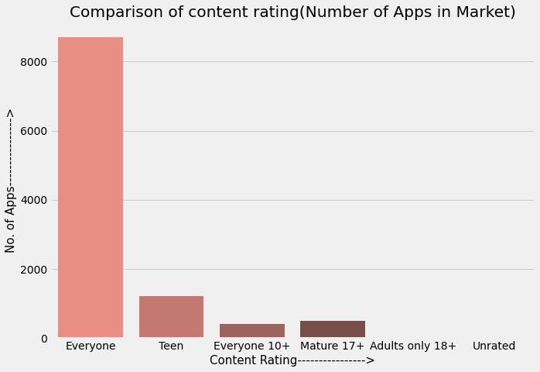
Comparison of content rating (Number of Apps in Market)
From the above plot we can see that most of the content ratings are from 'Everyone' Category.

Slide 21

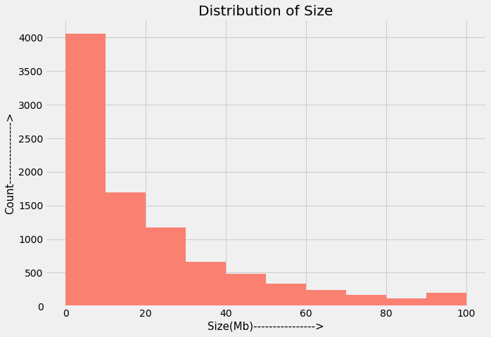
Distribution of Apps according to size
As we can see as the size of the app goes on increasing the number of counts goes on decreasing.

Slide 22
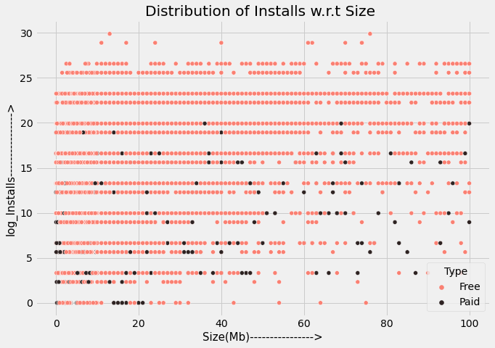
Distribution of Installs according to size
From the above scatter plot we can see that as the size increases the number of installs is less

Slide 23
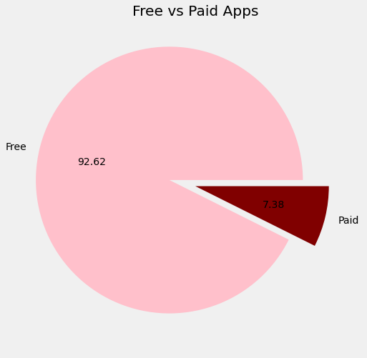
Free Vs Paid Applications
From the piechart we can see that 92.62% of apps in google play store are free and 7.38% are paid.

Slide 24
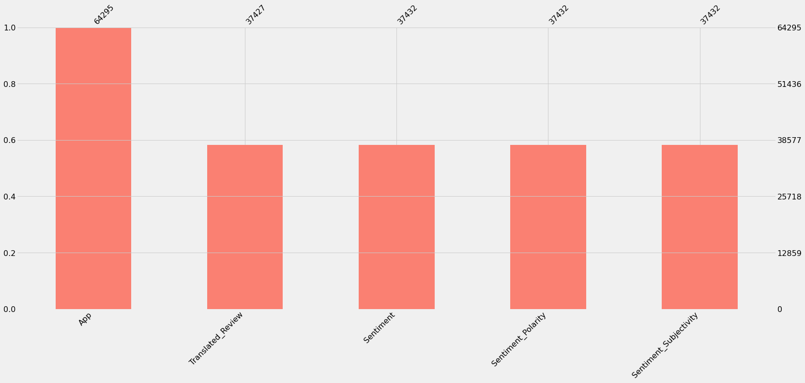
Sentiment analysis
From the above chart we can conclude that there are null values present in the Translated_Review, Sentiment,Sentiment_polarity and Sentiment_subjectivity columns.

Slide 25

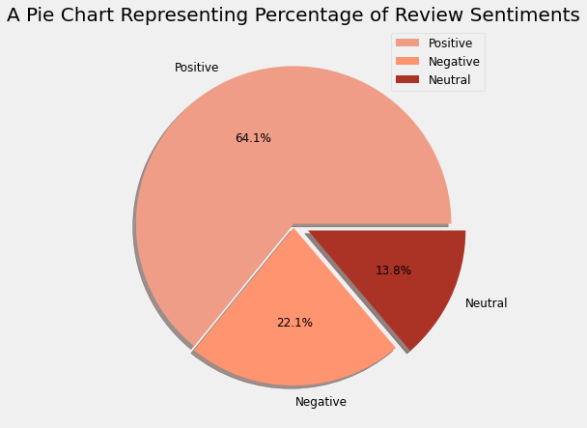
Percentage of Review Sentiments
It can be seen from above chart that positive reviews are more than negative reviews.

Slide 26
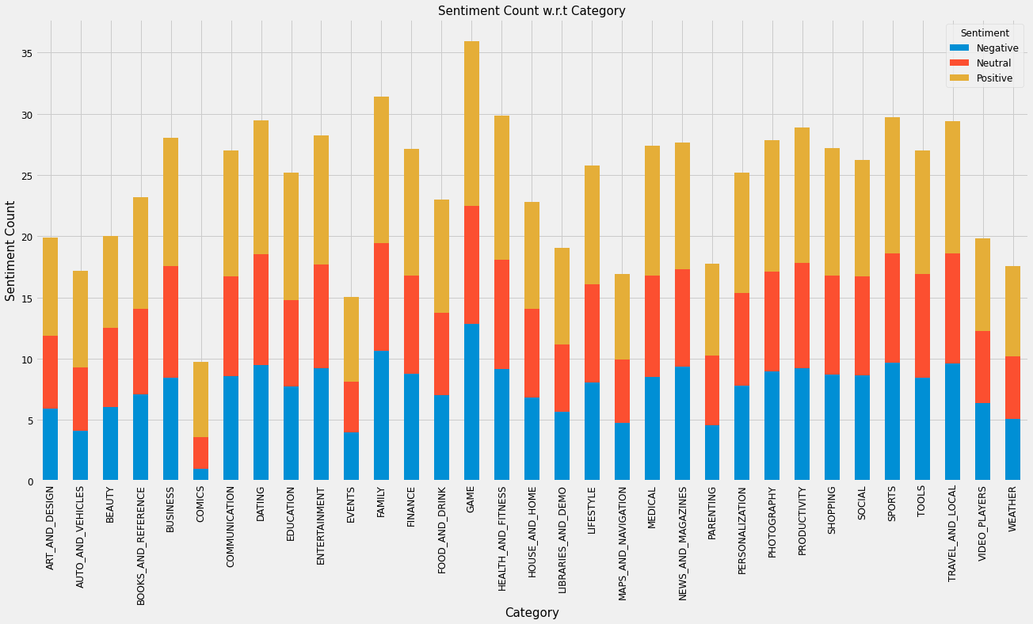
Sentiment Count w.r.t. category
Positive sentiment count is more for many apps than negative count.

Slide 27
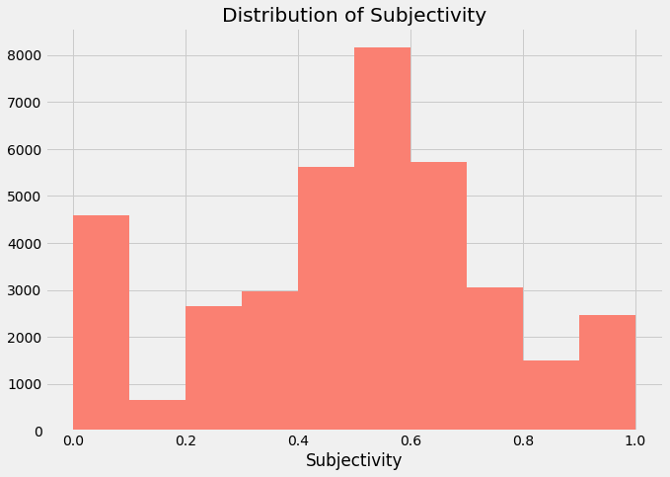
Distribution of Subjectivity
It can be seen that the maximum number of sentiment subjectivity lies between 0.4 to 0.7.
From this, we can conclude that the maximum number of the audience give reviews to the applications, according to their experience.
The higher subjectivity means that the text contains personal opinion rather than factual information.
Sentiment_Subjectivity > 0.5(refers to that mostly it is public opinion and not a piece of factual information)

Slide 28
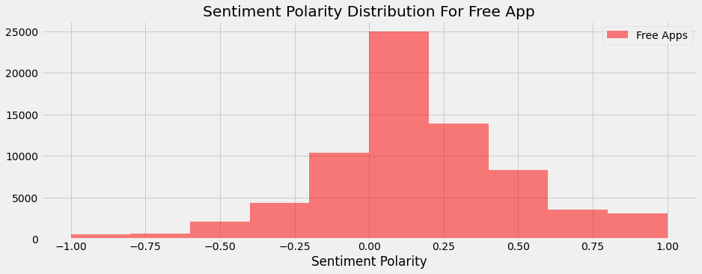
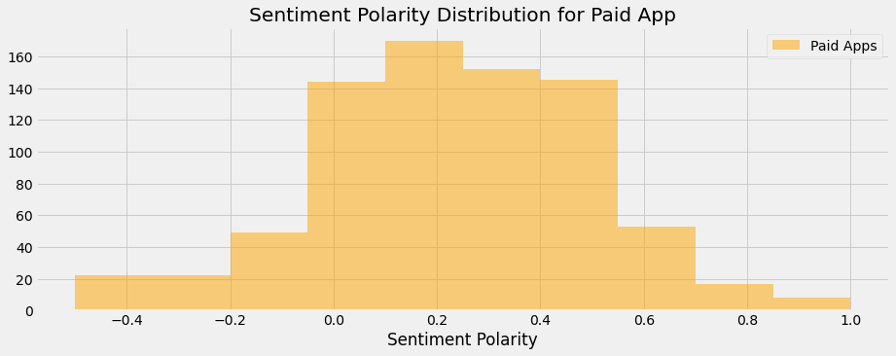
Sentiment Polarity Distribution for free and paid Apps
paid apps have positive sentiment polarity as compared to free apps.
While free apps have neutral sentiment polarity.

Slide 29

Insights from data
The dataset contains possibilities to deliver insights to understand customer demands better and thus help developers to popularize the product.
Dataset can also be used to look whether the original ratings of the app matches the predicted rating to know whether the app is performing better or worse compared to other apps on the Play Store.
Sentiment Polarity
The polarity of a sentiment measures how negative or positive the context is.
In the data that we have, the polarity ranges from -1 (most negative) to +1 (most positive).
Future Work
Exploring the correlation between the size of the app and the version of Android on the number of installs.
Exploring reviews and sentiment of the users as per the the category of the application.

Slide 30
Conclusion
Most reviews are for category of 'Family' and 'Game'.
Most installed apps are from 'GAME' and 'COMMUNICATION' Category.
Top installed games are 'Subway Surfers', ' Candy Crush Saga' , 'Temple Run 2'and 'Pou'.
Free apps have more number of Ratings than the paid apps.
Paid apps have more positive user reviews than the free apps while free apps have more number of negative reviews than paid apps.
Positive sentiment percentage for paid apps is more than the free apps.
Notes:
How every feature has a unique impact on the story
Why exploring data is important before starting to build ML models
How visualizations make anything interesting.
There's a hell lot of competition in Android market.
Thank You !!!!

Slide 31
References
geeksforgeeks
stackoverflow
w3schools

Slide 32
Thank You!!!!
Notes:
Thank you very much for listening

